Slide 1
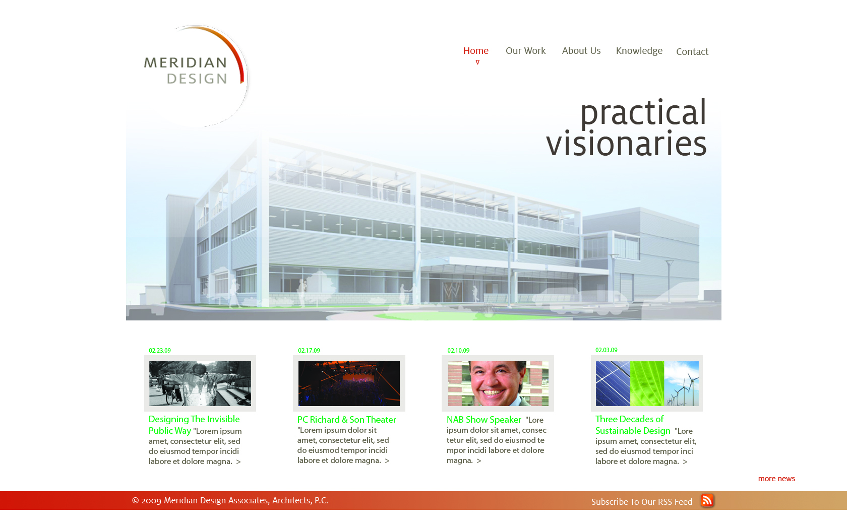
Home

Slide 2
Home
To the top header, we
Want to add
Collaboration Spaces
The images would be tied to the tag line and it is something that we can update on our own (?)
Part of the flash (?)
Intro. We have like 3 or 4 taglines: practical visionaries, humanizing space & ideas animate architecture
Just as you proposed with your layout – we loved it. News, updates, blogs – constantly updating – love it.

Slide 3
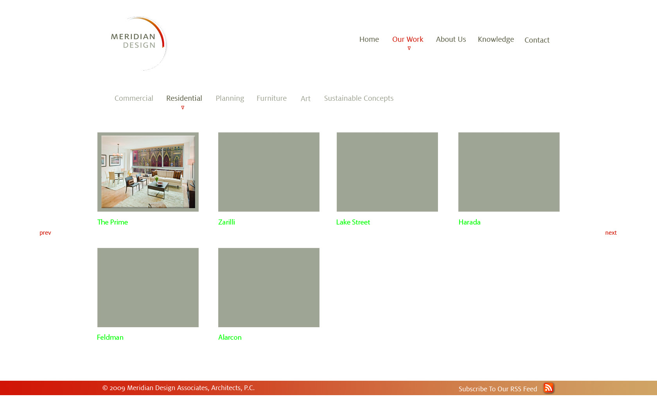
Our Work

Slide 4
I really like these two
Our Work
http://www.dannydiablo.de/
http://www.robertdannphotography.co.uk/portfolio/weddings/bride.php
http://www.visualboxsite.com/#work_02
http://www.legworkstudio.com/#/work/14
http://stopdesign.com/portfolio/
This could
Expand into
A “filmstrip” or
Similar.
Examples to the
Right are from the
Cssremix site you
Directed me to.
http://fyates.com/
This is super interesting – in that I like how the thingy on the left scrolls with you and the pictures rotate.

Slide 5
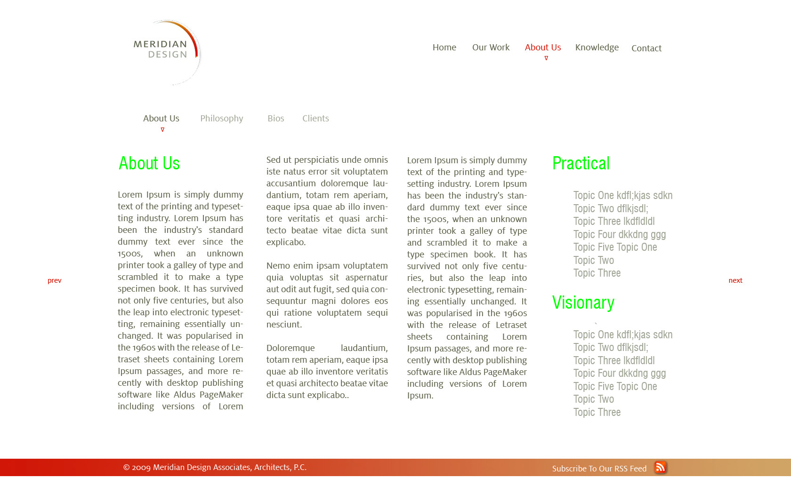
About Us/Philosophy/Bios, etc

Slide 6
About Us/Philosophy/Bios, etc
These are our text-rich
Pages(s). We can add images,
Et cetera as we go along.

Slide 7
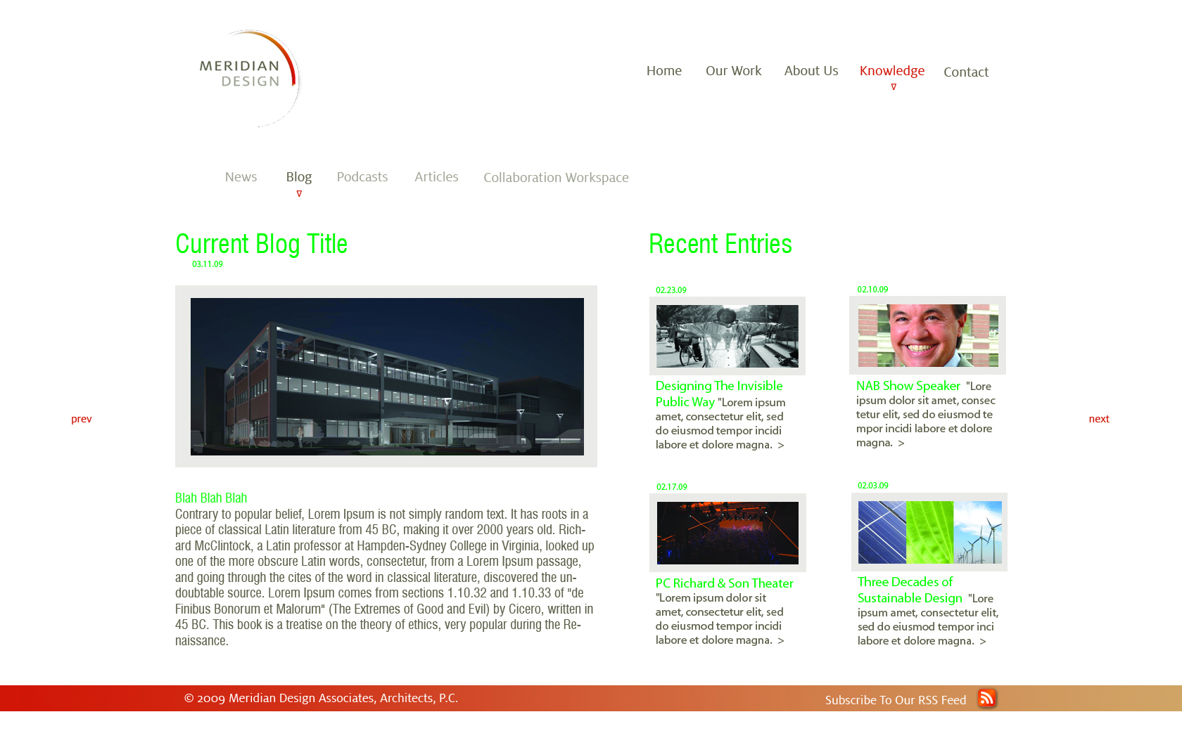
News, Blog, Podcast, Articles, etc

Slide 8
News, Blog, Podcast, Articles, etc
http://www.orangecoat.com/blog
http://www.jeffsarmiento.com/portfolio/
I like the basic blog structure
I like the Tweets
I “borrowed” this from a website I like. I think it is crisp and clean and it can be used for our news and blogs and more…
http://www.whoorayrecords.com/press.php

